Slide 1
CS 4900 Project Week 5
Group: 6
Michael Hayes
Ryan Slaybaugh
Semira Pinder

Slide 2

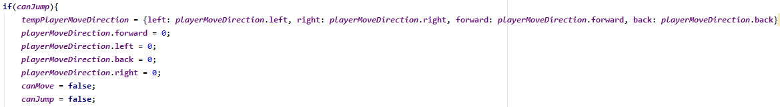
Fixing Movement
Created canMove and canJump Booleans.
Added if statements to check the boolean values.
If jump canJump = false; canMove = false;
Player movement is saved to be used later.

Slide 3
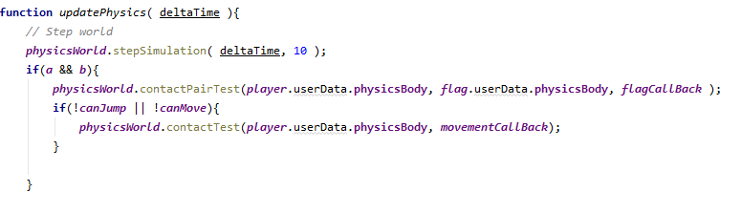
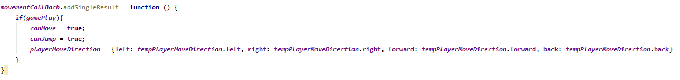
Continued.
If player collides with platform, it resets canMove and canJump.
Movement is reapplied for seamless movement when holding W.

Slide 4

Dispatcher and Manifolds
Dispatcher does calculations for overlapping pairs
A manifold keeps track of the information of a single collision.

Slide 5
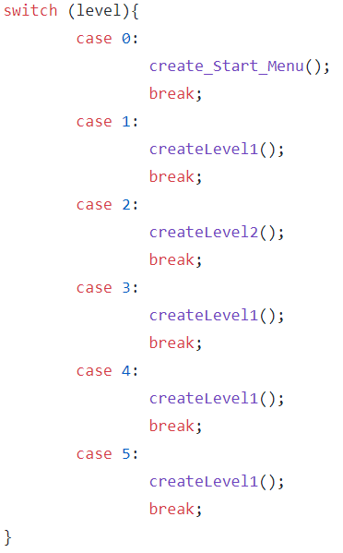
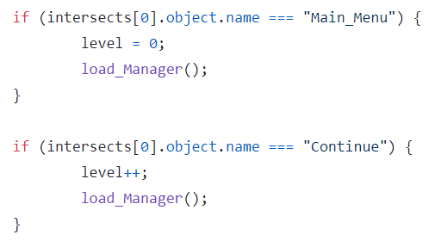
In Game Menu
Switch case to load levels
Raycaster click Eventhandler

Slide 6
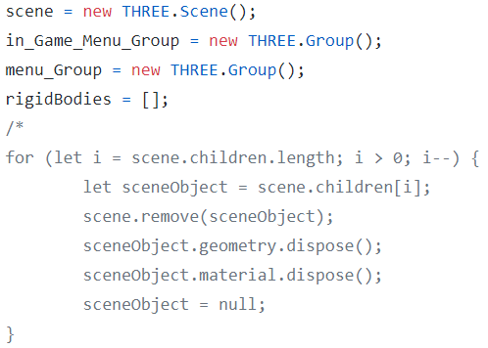
Issues
Handling of old objects
Multiple Render calls?
Much work ahead

Slide 7
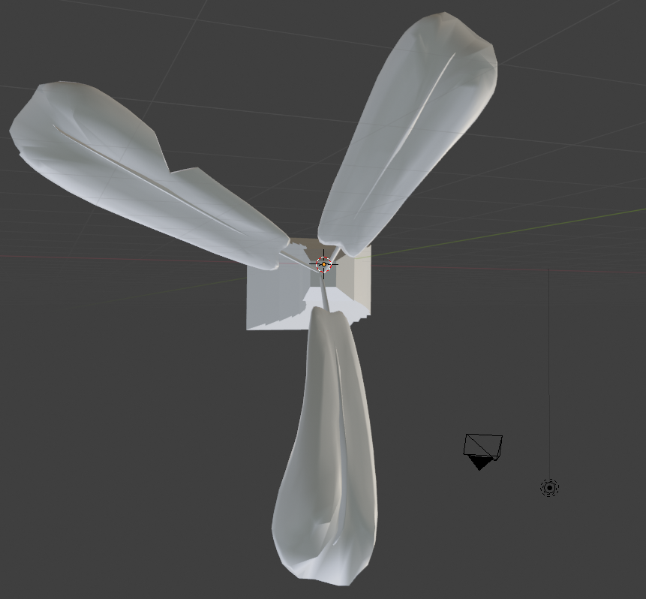
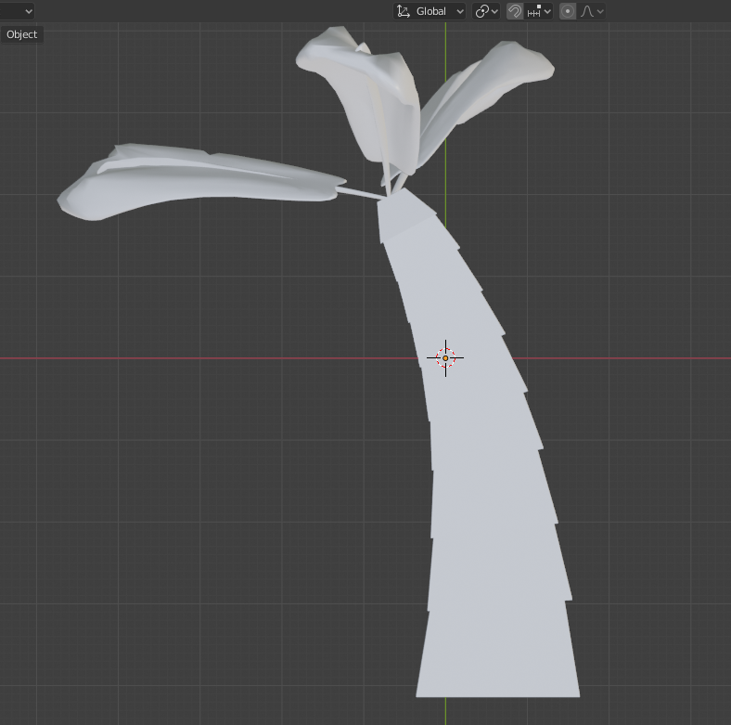
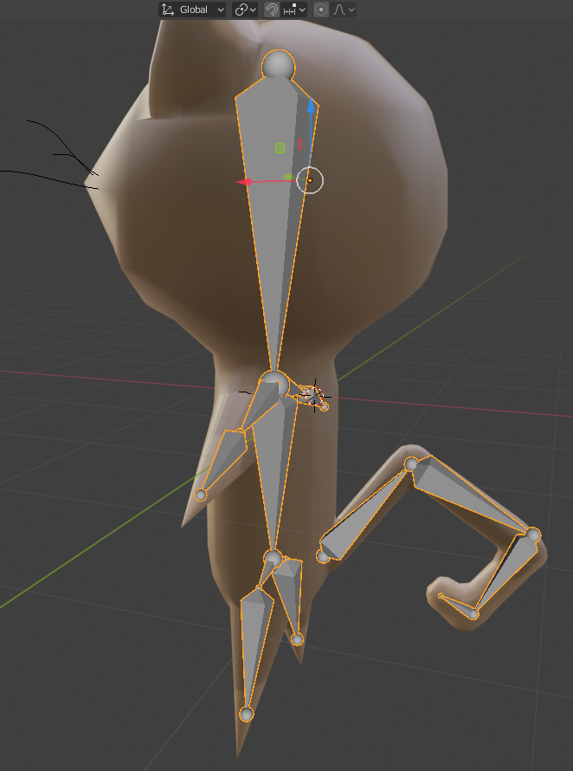
Model changes and additions

Slide 8
Problems with animations
Difficulty playing
Pausing, enabling and looping the animations
Animation mixer doesn’t update the animations correctly

Slide 9
Next Week.
Get started on grappling hook feature.
Play animations correctly, make level designs and fine tune animations
Work on rendering issue when switching levels/menus
Look at Sprites for in game menu

